Slide 1
PROBLEMS ON SLA
Courtesy:NPTEL Online Course on Cloud Computing by Prof. Soumya K. Ghosh, IIT Kharagpur

Slide 2
SLA
What is Service Level Agreement?
A formal contract between a Service Provider (SP) and a Service Consumer (SC)
Courtesy:NPTEL Online Course on Cloud Computing by Prof. Soumya K. Ghosh, IIT Kharagpur

Slide 3
SLA: foundation of the consumer’s trust in the provider
Purpose : to define a formal basis for performance and availability the SP guarantees to deliver
Courtesy:NPTEL Online Course on Cloud Computing by Prof. Soumya K. Ghosh, IIT Kharagpur

Slide 4
SLA contains Service Level Objectives (SLOs)
– Objectively measurable conditions for the service
– SLA & SLO: basis of selection of cloud provider
Courtesy:NPTEL Online Course on Cloud Computing by Prof. Soumya K. Ghosh, IIT Kharagpur

Slide 5
SLA Contents
A set of services which the provider will deliver
A complete, specific definition of each service
The responsibilities of the provider and the consumer
A set of metrics to measure whether the provider is offering the services as guaranteed
An auditing mechanism to monitor the services
The remedies available to the consumer and the provider if the terms are not satisfied
How the SLA will change over time
Courtesy:NPTEL Online Course on Cloud Computing by Prof. Soumya K. Ghosh, IIT Kharagpur

Slide 6
Service Level Objectives (SLOs)
Objectively measurable conditions for the service
Encompasses multiple QoS parameters viz. availability, serviceability, billing, penalties, throughput, response time, or quality
Example :
– “Availability of a service X is 99.9%”
– “Response time of a database query Q is between 3 to 5 seconds”
– “Throughput of a server S at peak load time is 0.875”
Courtesy:NPTEL Online Course on Cloud Computing by Prof. Soumya K. Ghosh, IIT Kharagpur

Slide 7
Key Performance Indicators (KPIs)
Low-level resource metrics
Multiple KPIs are composed, aggregated, or converted to high-level SLOs.
Example :
– downtime, uptime, inbytes, outbytes, packet size, etc.
Possible mapping :
– Availability (A) = 1 – (downtime/uptime)
Courtesy:NPTEL Online Course on Cloud Computing by Prof. Soumya K. Ghosh, IIT Kharagpur

Slide 8
Monitoring:
– Natural questions:
“who should monitor the performance of the provider?”
“does the consumer meet its responsibilities?”
– Solution: neutral third-party organization to perform monitoring
– Eliminates conflicts of interest if:
Provider reports outage at its sole discretion
Consumer is responsible for an outage
Courtesy:NPTEL Online Course on Cloud Computing by Prof. Soumya K. Ghosh, IIT Kharagpur

Slide 9
Auditability
– Consumer requirement:
Is the provider adhering to legal regulations or industry-standard
SLA should make it clear how and when to conduct audits
Courtesy:NPTEL Online Course on Cloud Computing by Prof. Soumya K. Ghosh, IIT Kharagpur

Slide 10
– Metrics for Monitoring and Auditing
• Throughput – How quickly the service responds
• Availability – Represented as a percentage of uptime for a service in a given observation period.
• Reliability – How often the service is available
• Load balancing – When elasticity kicks in (new VMs are booted or terminated, for example)
• Durability – How likely the data is to be lost
• Elasticity – The ability for a given resource to grow infinitely, with limits (the maximum amount of storage or bandwidth, for example) clearly stated
• Linearity – How a system performs as the load increases
Courtesy:NPTEL Online Course on Cloud Computing by Prof. Soumya K. Ghosh, IIT Kharagpur

Slide 11
– Metrics for Monitoring and Auditing
• Agility – How quickly the provider responds as the consumer's resource load scales up and down
• Automation – What percentage of requests to the provider are handled without any human interaction
• Customer service response times – How quickly the provider responds to a service request. This refers to the human interactions required when something goes wrong with the ondemand, self-service aspects of the cloud.
• Service-level violation rate – Expressed as the mean rate of SLA violation due to infringements of the agreed warranty levels.
• Transaction time – Time that has elapsed from when a service is invoked till the completion of the transaction, including the delays.
• Resolution time – Time period between detection of a service problem and its resolution.
Courtesy:NPTEL Online Course on Cloud Computing by Prof. Soumya K. Ghosh, IIT Kharagpur

Slide 12
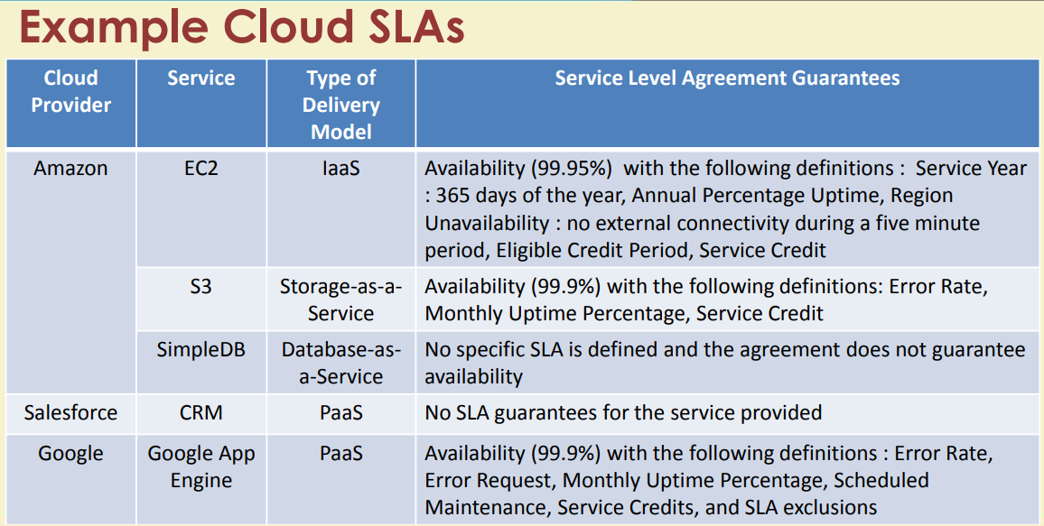
Example –Cloud SLAs
Courtesy:NPTEL Online Course on Cloud Computing by Prof. Soumya K. Ghosh, IIT Kharagpur

Slide 13
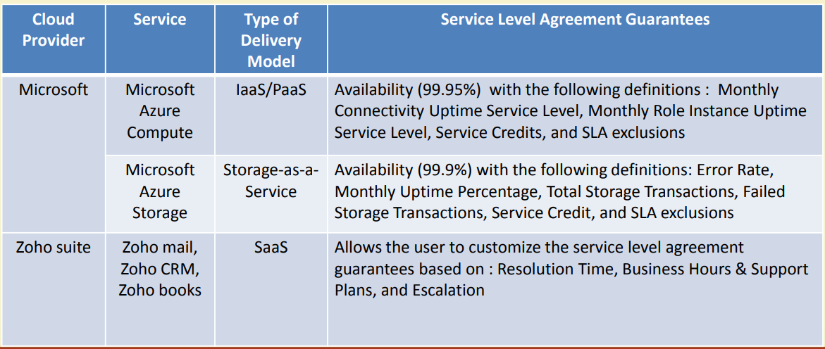
Example –Cloud SLAs
Courtesy:NPTEL Online Course on Cloud Computing by Prof. Soumya K. Ghosh, IIT Kharagpur

Slide 14
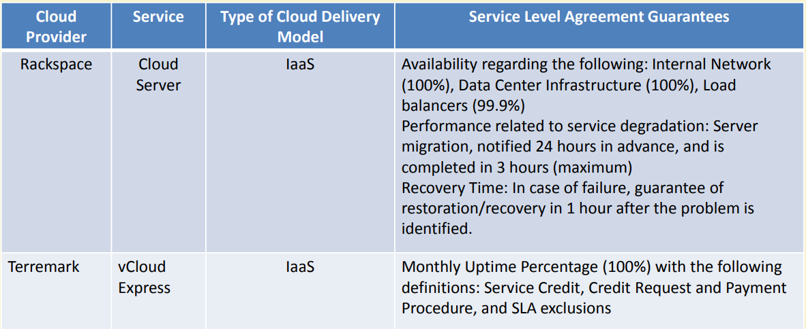
Example –Cloud SLAs
Courtesy:NPTEL Online Course on Cloud Computing by Prof. Soumya K. Ghosh, IIT Kharagpur

Slide 15
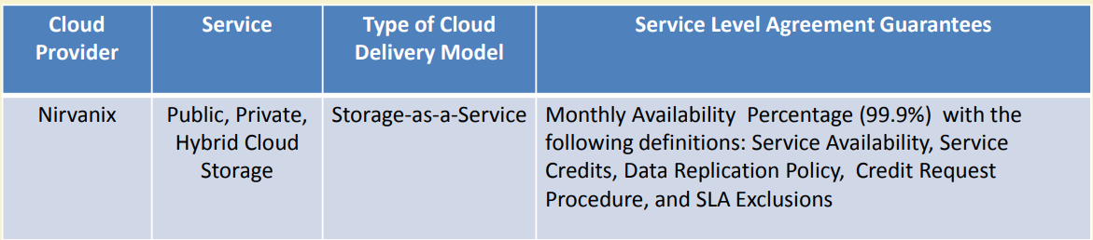
Example –Cloud SLAs
Courtesy:NPTEL Online Course on Cloud Computing by Prof. Soumya K. Ghosh, IIT Kharagpur

Slide 16

Courtesy:NPTEL Online Course on Cloud Computing by Prof. Soumya K. Ghosh, IIT Kharagpur

Slide 17
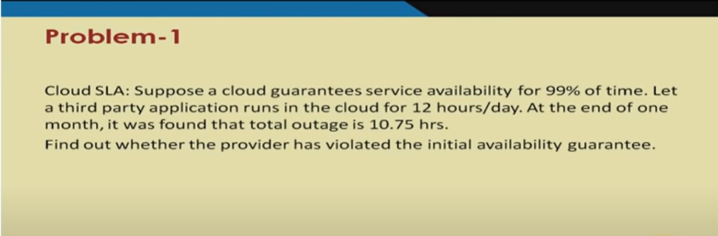
s
Courtesy:NPTEL Online Course on Cloud Computing by Prof. Soumya K. Ghosh, IIT Kharagpur

Slide 18
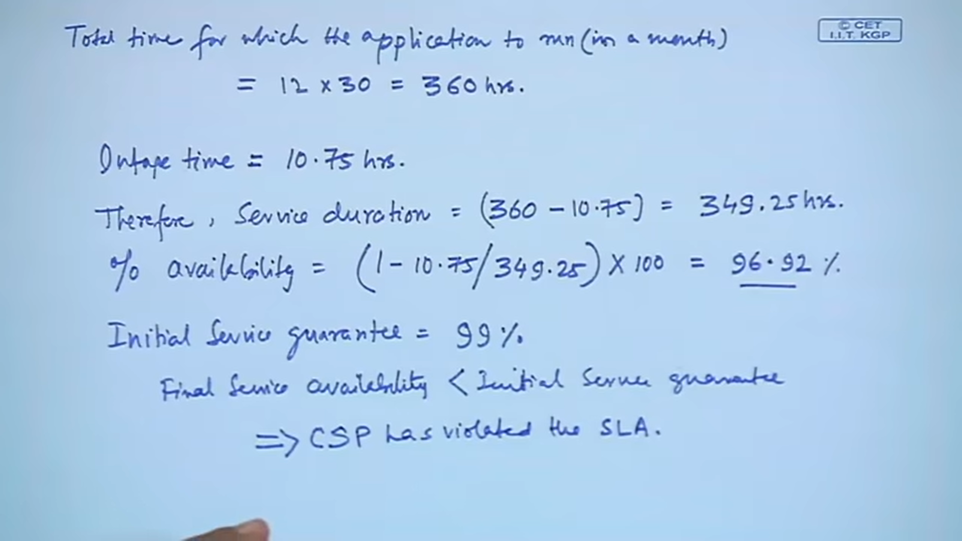
Courtesy:NPTEL Online Course on Cloud Computing by Prof. Soumya K. Ghosh, IIT Kharagpur

Slide 19
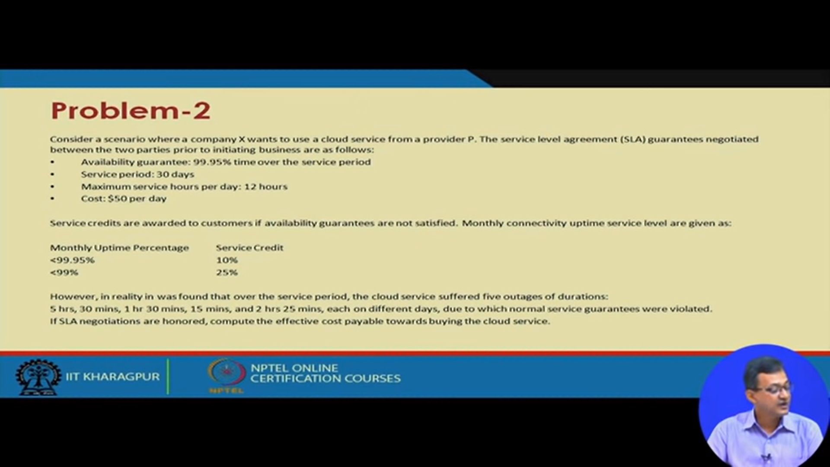
Courtesy:NPTEL Online Course on Cloud Computing by Prof. Soumya K. Ghosh, IIT Kharagpur

Slide 20
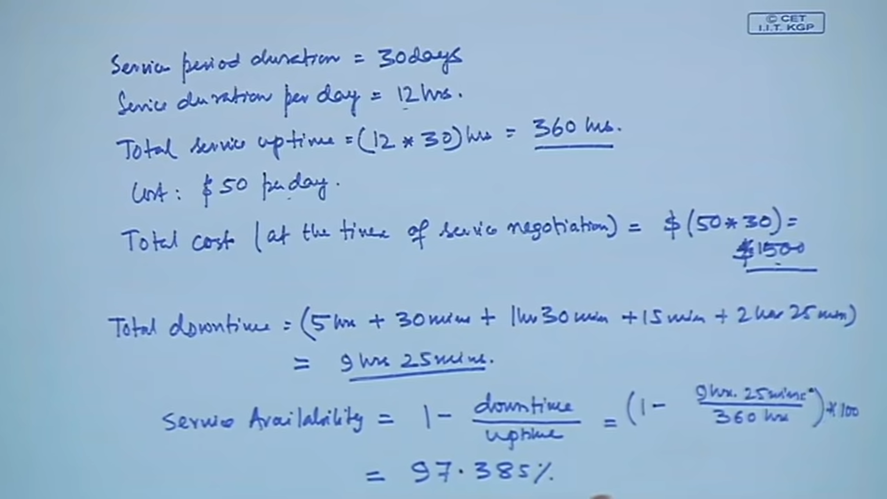
Courtesy:NPTEL Online Course on Cloud Computing by Prof. Soumya K. Ghosh, IIT Kharagpur

Slide 21
Uptime=360hrs-9hrs and 40 mins=350 hrs 20 mins
+ 15 mins=9 hrs 40 mins
=(1- 9hrs 40 mins/350 hrs 20 mins) X 100
=(1- 9.66 hrs/350.33 hrs) X 100
=0.97242 X 100
=97.24%
Courtesy:NPTEL Online Course on Cloud Computing by Prof. Soumya K. Ghosh, IIT Kharagpur

Slide 22
Uptime=360hrs-9hrs and 40 mins=350 hrs 20 mins
+ 15 mins=9 hrs 40 mins
=(1- 9hrs 40 mins/350 hrs 20 mins) X 100
=(1- 9.66 hrs/350.33 hrs) X 100
=0.97242 X 100
=97.24%
Courtesy:NPTEL Online Course on Cloud Computing by Prof. Soumya K. Ghosh, IIT Kharagpur

Slide 23
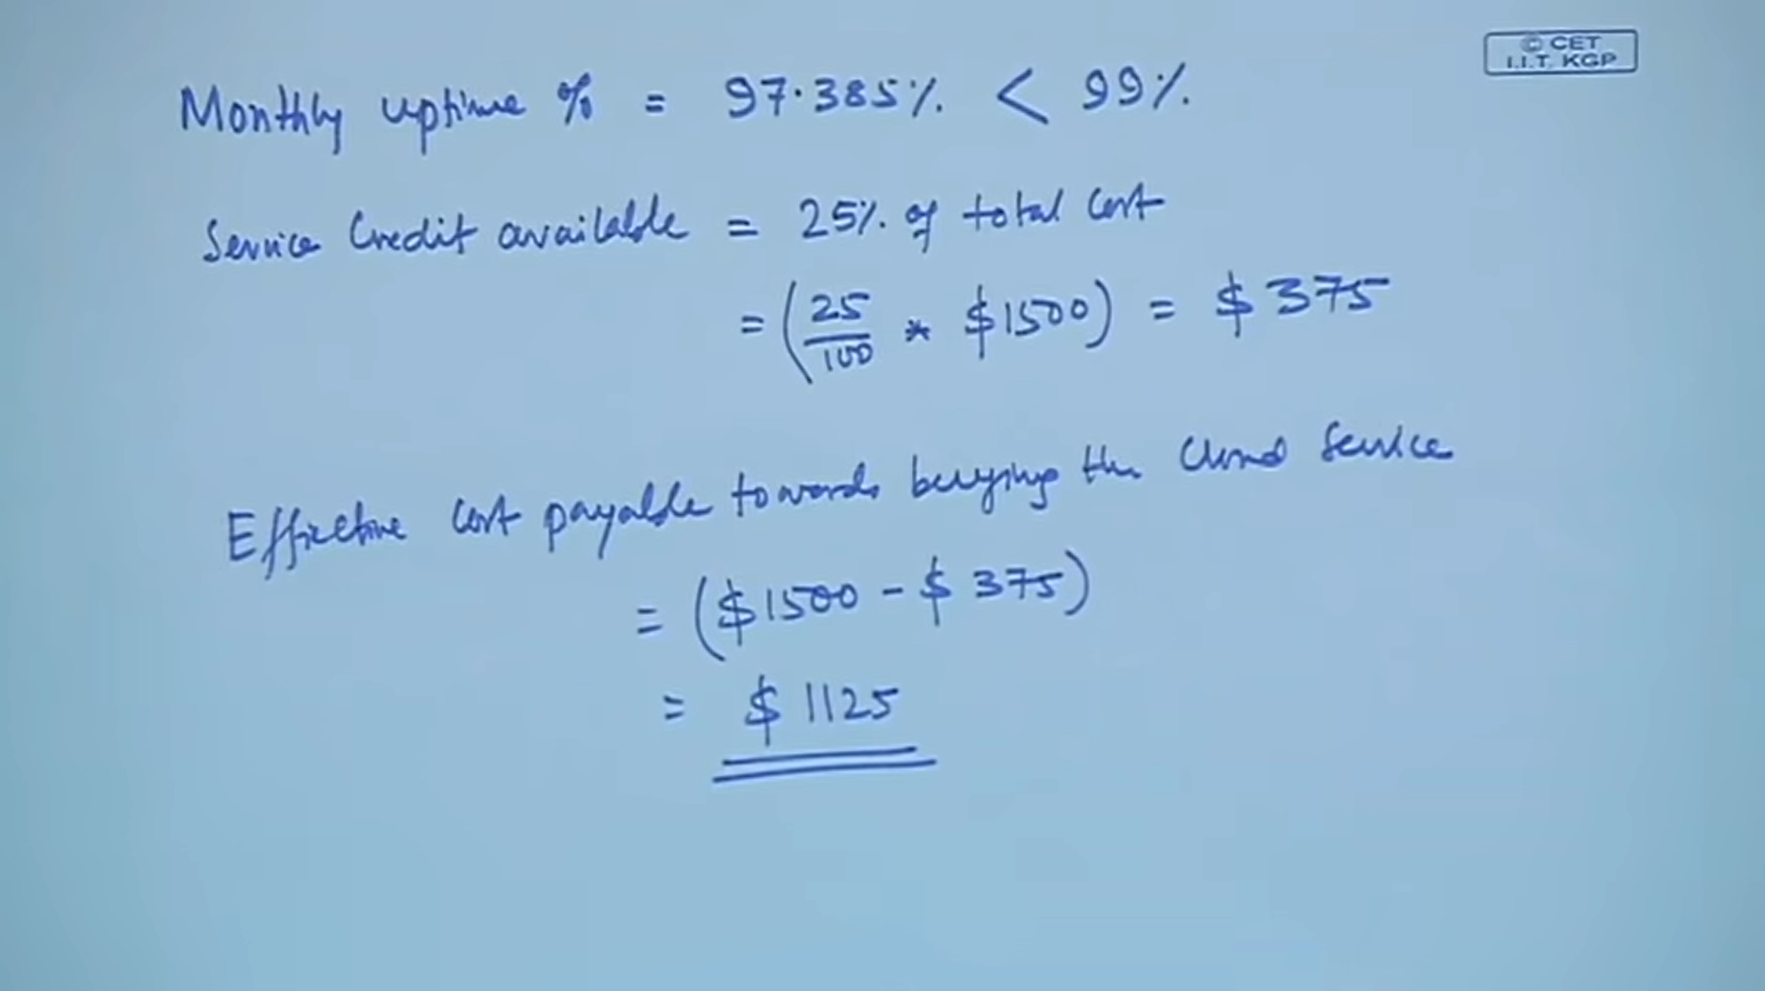
Courtesy:NPTEL Online Course on Cloud Computing by Prof. Soumya K. Ghosh, IIT Kharagpur

